Slide 1
Software Engineering Project: Sports Event Calendar Application
Prepared by: Julia Bogdani, Krisa Zhanasi, Eno Myderizi

Slide 2
Introduction:
Welcome to iSports, a user-friendly web application designed specifically as a calendar for sports events. With iSports, sports enthusiasts can effortlessly stay updated on the latest games, tournaments, and matches happening around them.
To get started, every user is required to sign up and create their own profile. This profile becomes your personal space within iSports, allowing you to manage your event preferences and stay organized. You can access your profile page at any time to view and update your information.
One of the key features of iSports is the ability to create your own sports events. As a user, you have the power to organize and register your own games, tournaments, or matches. Simply provide the necessary details such as event title, date, time, location, and event type, and iSports will take care of the rest.

Slide 3
Introduction:
In addition to creating events, iSports provides you with a comprehensive sports event calendar. You can easily register for upcoming sports events by browsing through the calendar and selecting the ones that interest you.
iSports offers an event details page where you can find all the necessary information about specific events. From event descriptions to location details and even a map visualization, you'll have everything you need to make informed decisions and enjoy your sports experiences to the fullest.

Slide 4
Project Goal:
The goal of iSports is to provide sports enthusiasts with a user-friendly web application that serves as a comprehensive sports event calendar. The application enables users to sign up, create their profile, and stay updated on the latest sports events happening around them. Users can register for events, create their own sports events, and manage their event schedule effectively. The project aims to simplify the process of event organization, discovery, and attendance, enhancing the overall sports experience for users.

Slide 5
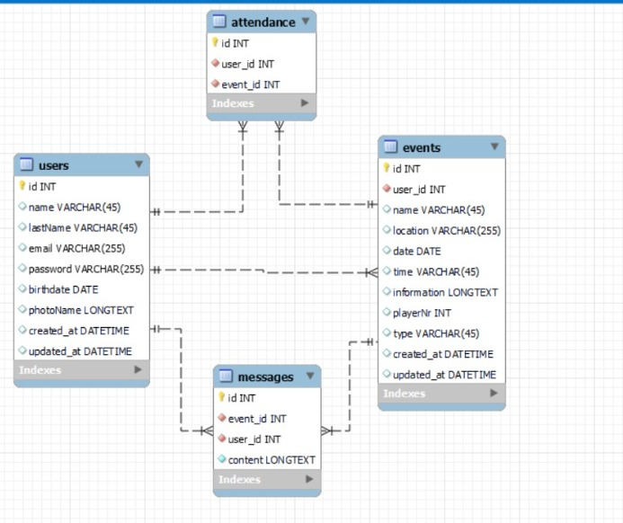
Database:
Event Registration:
Users can register events on the platform.
The Event Table stores event information, including a unique ID, user ID (the person who created the event), name, date, location, time, information, player number, and type of event. Each event is associated with a user who created it.
User Registration:
Users can create accounts on the platform.
The User Table stores user information, including a unique ID, name, last name, email, password, birthday, and photo name.
Users can authenticate using their email and password to access the platform.
A connection is established between the user and the event they create.

Slide 6
Database:
Messaging:
Attendance:
Messaging:
Users can exchange messages related to events.
The Messages Table facilitates a many-to-many relationship between users and events.
Each message is associated with a user who wrote it and an event it belongs to.
Attendance:
Users can indicate their attendance at events.
The Attendance Table establishes a many-to-many relationship between users and events.
For each event, multiple users can attend, and also multiple events can have attendees.
The table records the user ID and event ID for attendance tracking.

Slide 7
Application Specifications:
Technology Stack:
User Authentication and Authorization:
Backend Framework: Flask (Python)
Frontend Framework: HTML, CSS, JavaScript
Database: MySQL
Web Server: LocalHost
Users should be able to register and log in to the application.
Passwords should be securely stored using encryption.
User roles should be implemented to differentiate between administrators and regular users.

Slide 8
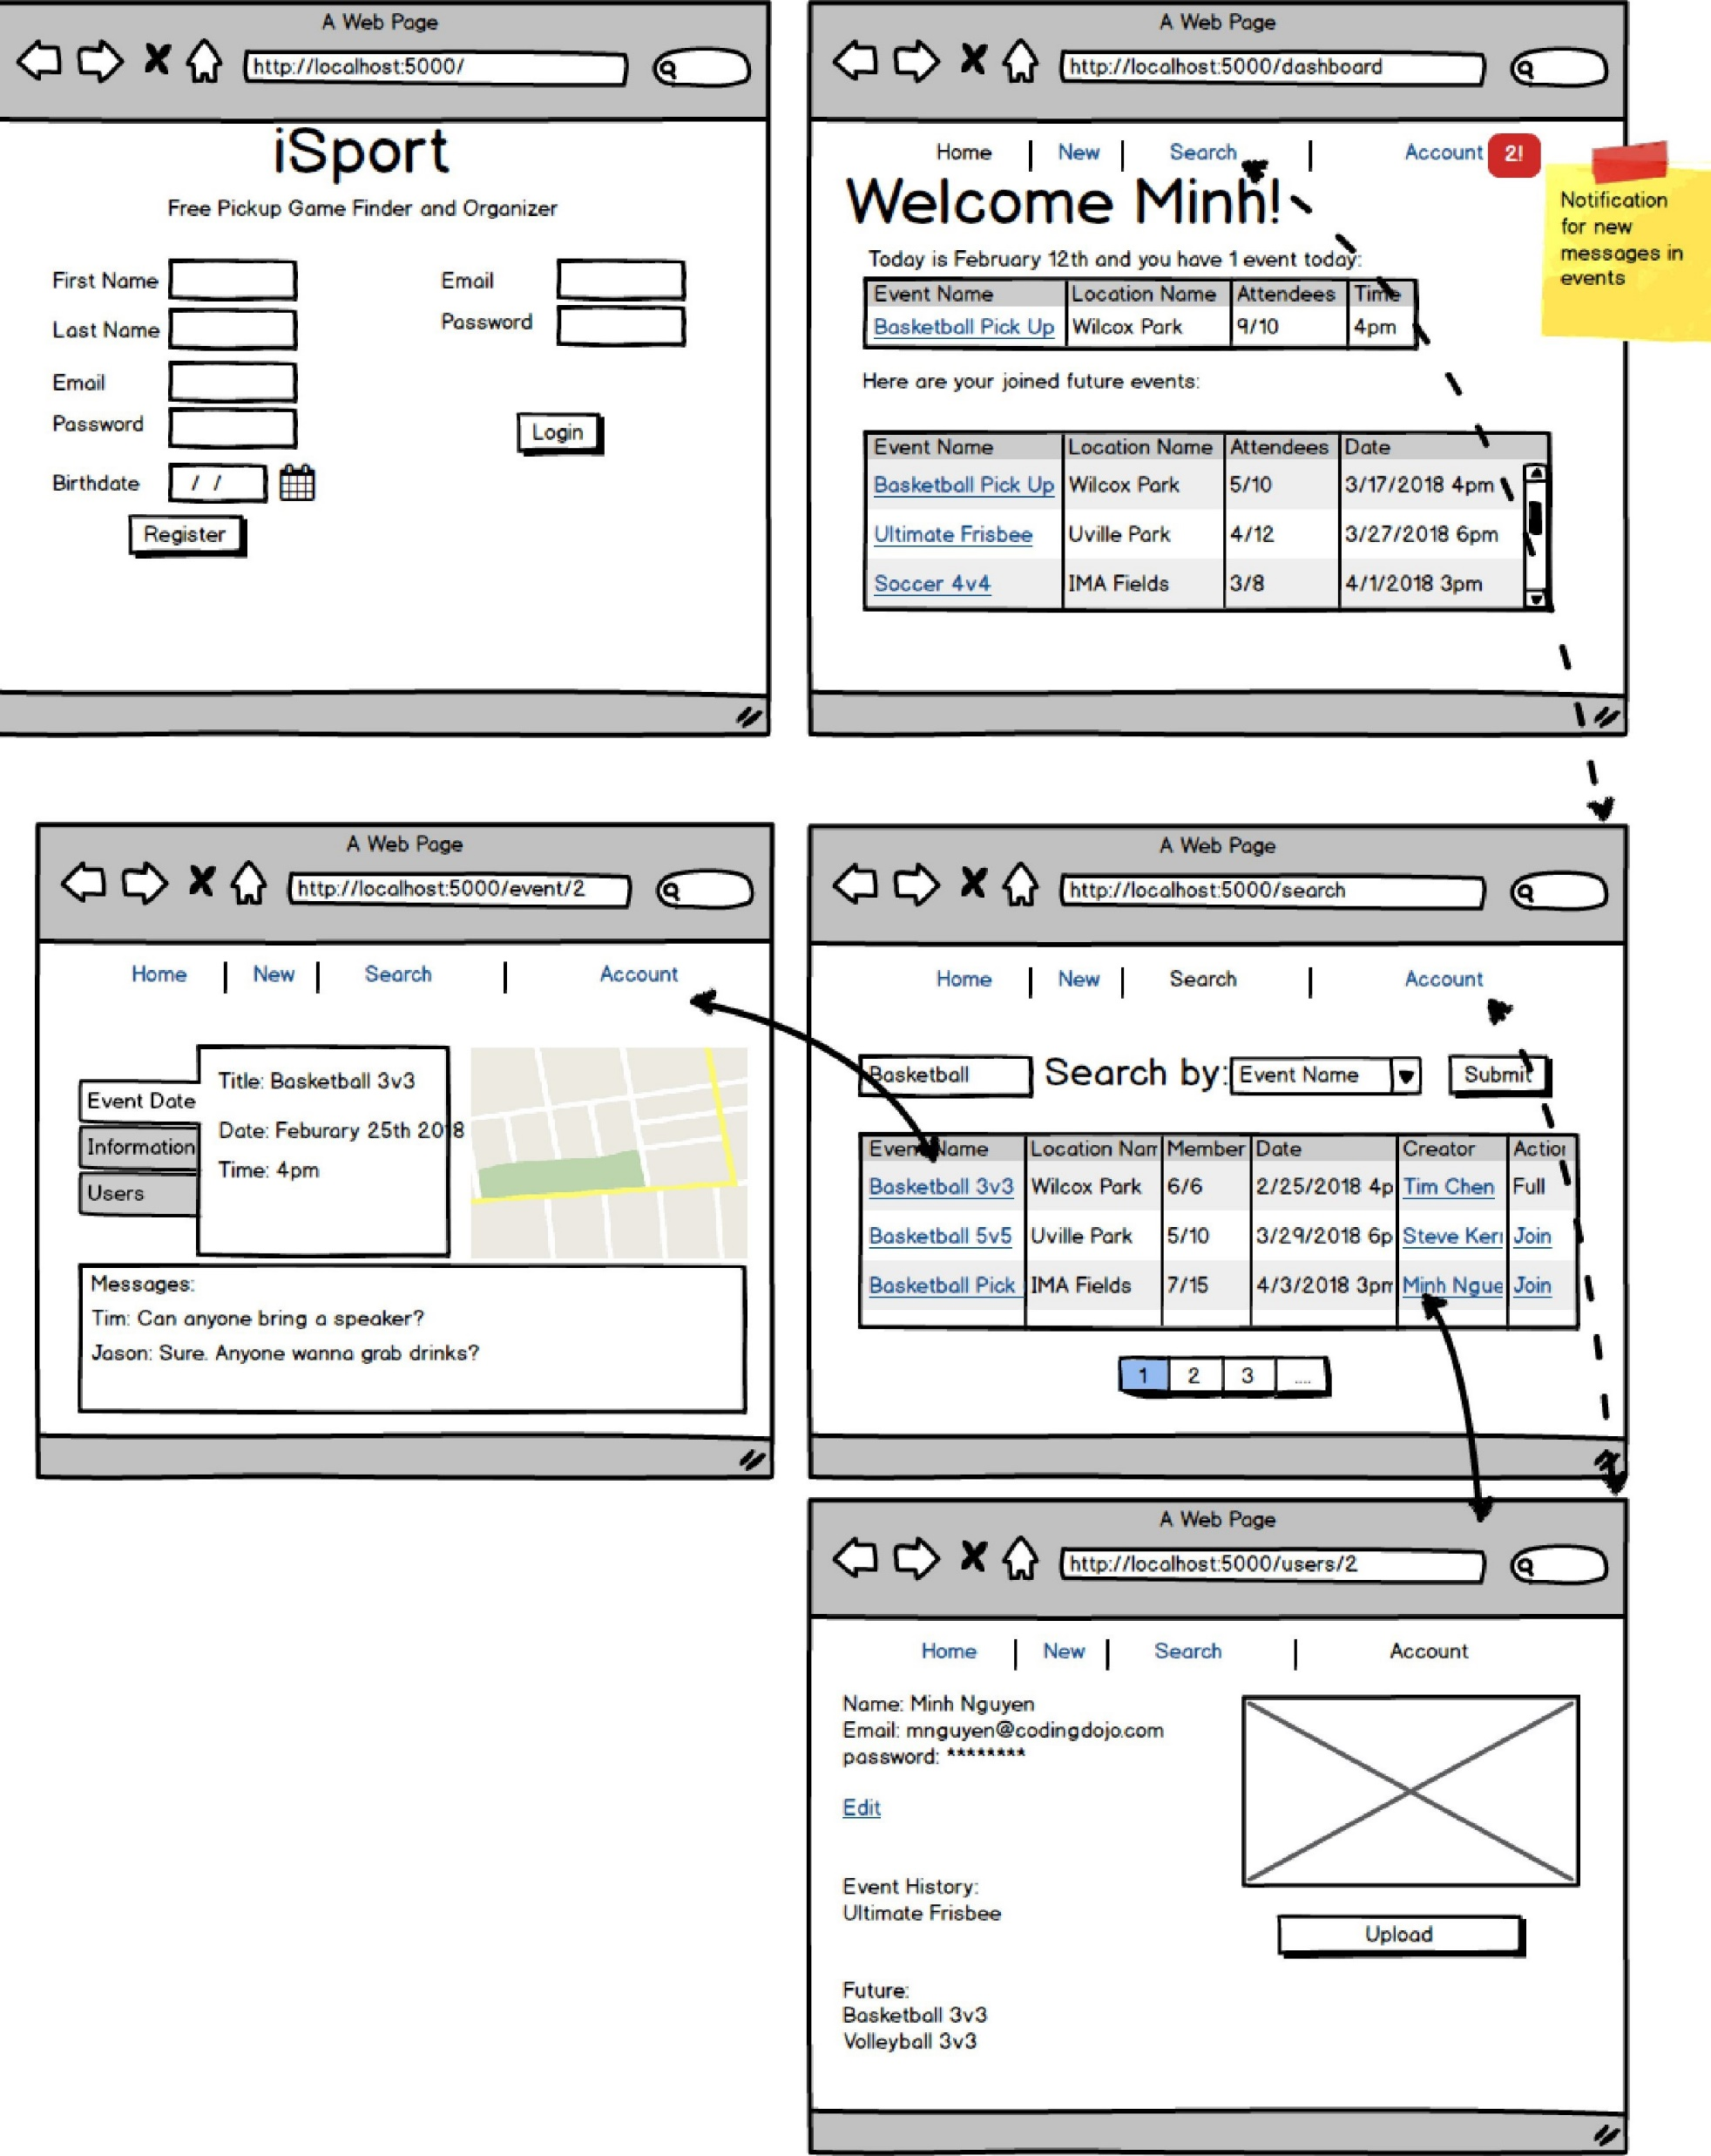
Software Design and Modeling
In the iSports project, careful attention has been given to software design and modeling to ensure a well-structured and efficient application. The design phase involved creating a clear architectural framework using the Flask framework, which is a lightweight and flexible backend framework written in Python. This choice allows for the seamless integration of various components and functionalities.
During the modeling phase, the team created a comprehensive database schema using MySQL to store and organize event data, user information, messaging, and attendance details. This database design facilitates efficient data retrieval and manipulation, ensuring optimal performance of the application.
In addition to the database modeling, the team employed HTML, CSS, and JavaScript to design the user interface and enhance the application's visual appeal and usability. The front-end design follows best practices in web development, ensuring a responsive and intuitive experience for users across different devices.

Slide 9
Thank You!

